Slide 1
Doubly Linked List

Slide 2
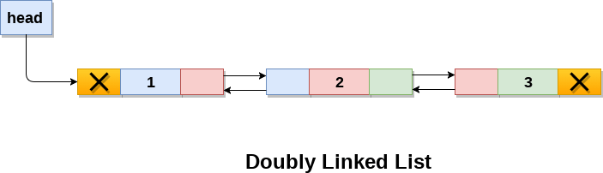
Doubly linked list
Doubly linked list is a complex type of linked list in which a node contains a pointer to the previous as well as the next node in the sequence. Therefore, in a doubly linked list, a node consists of three parts: node data, pointer to the next node in sequence (next pointer) , pointer to the previous node (previous pointer). A sample node in a doubly linked list is shown in the figure.
In C, structure of a node in doubly linked list can be given as :
struct node
{
struct node *prev;
int data;
struct node *next;
}

Slide 3
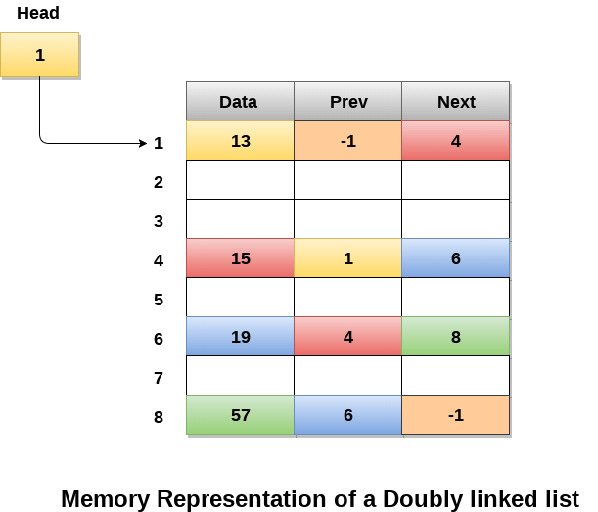
Memory Representation of a doubly linked list
Memory Representation of a doubly linked list is shown in the following image. Generally, doubly linked list consumes more space for every node and therefore, causes more expansive basic operations such as insertion and deletion. However, we can easily manipulate the elements of the list since the list maintains pointers in both the directions (forward and backward).

Slide 4
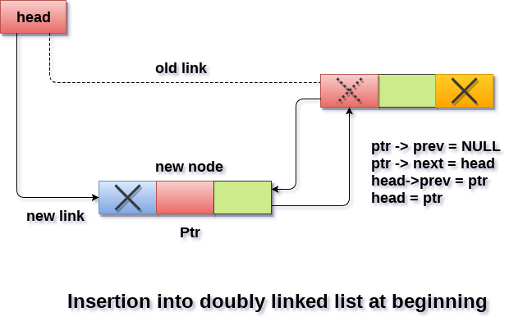
Insertion in doubly linked list at beginning

Slide 5
Algorithm :
Step 1: IF ptr = NULL
Write OVERFLOW Go to Step 8 [END OF IF]
Step 2: SET NEW_NODE = ptr
Step 3: SET NEW_NODE -> DATA = VAL
Step 4: SET NEW_NODE -> PREV = NULL
Step 5: SET NEW_NODE -> NEXT = START
Step 6: SET head -> PREV = NEW_NODE
Step 7: SET head = NEW_NODE
Step 8: EXIT

Slide 6
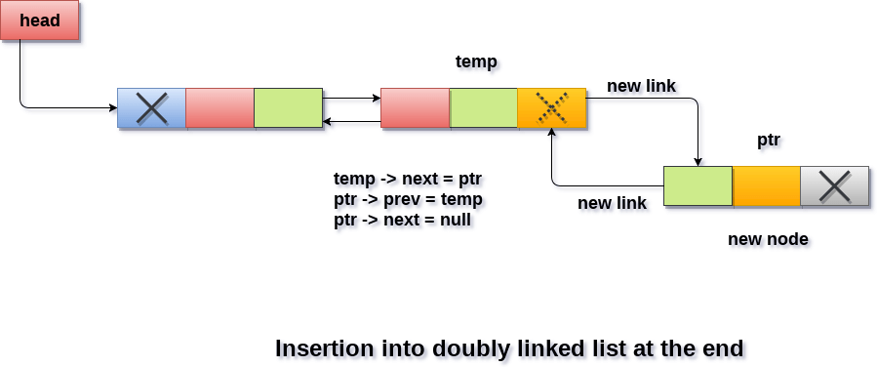
Insertion in doubly linked list at the end

Slide 7
Algorithm
Step 1: IF PTR = NULL
Write OVERFLOW Go to Step 10 [END OF IF]
Step 2: SET NEW_NODE = PTR
Step 3: SET NEW_NODE -> DATA = VAL
Step 4: SET NEW_NODE -> NEXT = NULL
Step 5: SET TEMP = START
Step 6: Repeat Step 8 while TEMP -> NEXT != NULL
Step 7: SET TEMP = TEMP -> NEXT
[END OF LOOP]
Step 8: SET TEMP -> NEXT = NEW_NODE
Step 9: SET NEW_NODE -> PREV = TEMP
Step 10: EXIT

Slide 8
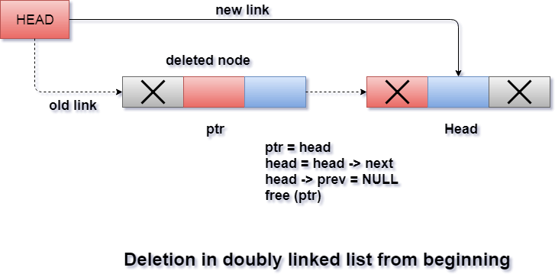
Deletion at beginning

Slide 9
Algorithm
STEP 1: IF HEAD = NULL
WRITE UNDERFLOW GOTO STEP 6
STEP 2: SET PTR = HEAD
STEP 3: SET HEAD = HEAD → NEXT
STEP 4: SET HEAD → PREV = NULL
STEP 5: FREE PTR
STEP 6: EXIT

Slide 10
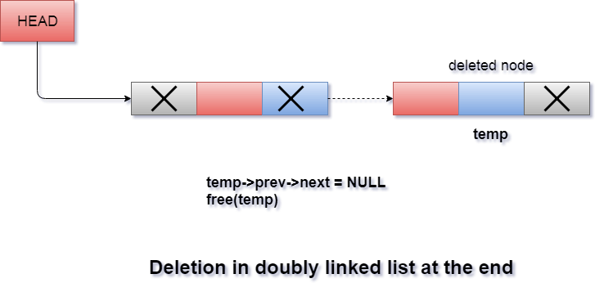
Deletion in doubly linked list at the end

Slide 11
ALGORITHM
Step 1: IF HEAD = NULL
Write UNDERFLOW Go to Step 7 [END OF IF]
Step 2: SET TEMP = HEAD
Step 3: REPEAT STEP 4 WHILE TEMP->NEXT != NULL
Step 4: SET TEMP = TEMP->NEXT
[END OF LOOP]
Step 5: SET TEMP ->PREV-> NEXT = NULL
Step 6: FREE TEMP
Step 7: EXIT

Slide 12
Algorithm
Step 1: IF HEAD == NULL
WRITE "UNDERFLOW" GOTO STEP 8 [END OF IF]
Step 2: Set PTR = HEAD
Step 3: Set i = 0
Step 4: Repeat step 5 to 7 while PTR != NULL
Step 5: IF PTR → data = item
return i [END OF IF]
Step 6: i = i + 1
Step 7: PTR = PTR → next
Step 8: Exit
Searching for a specific node in Doubly Linked List

Slide 13

Traversing in doubly linked list
Algorithm
Step 1: IF HEAD == NULL
WRITE "UNDERFLOW" GOTO STEP 6 [END OF IF]
Step 2: Set PTR = HEAD
Step 3: Repeat step 4 and 5 while PTR != NULL
Step 4: Write PTR → data
Step 5: PTR = PTR → next
Step 6: Exit

